Slide 1

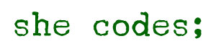
Global Activism
Eti Mayer
Final Project – NOV 2021

Slide 2

Eti mayer
Junior Data Scientist – Certified DS from Bar Ilan
DS Skills: ML Models, R, Python (DS packages), SQL Server
Financial back office in an activist hedge fund –
Experience:
She Code Final Project – Global Activism
Israeli Security Agency Hackathon 2021 – DS Team Lead
Final project in the DS course – NoShow dataset

Slide 3

Global Activism
Domain Field: Global Capital Market
Main Project Purpose: Predict Activists’ Campaign Succession for an Activism Follower Fund
Data Source: Purchased Database.
+ Edgar SEC database

Slide 4

WHAT IS AN ACTIVIST CAMPAIGN?
An activist investor buys a significant stake in a public company
Strategy: Influence on how the company is run, e.g.:
Obtaining seats on BOD.
Taking private
Etc.
Objective: Creating value to share holders:
>50% net IRR over ref index, S&P500

Slide 5
HOW TO FIND ACTIVISTS’ CAMPAIGNS?
Activist acquires more than 5% of voting class
Disclose purchase on a 13D form
Becomes a beneficial owner
Schedule 13D must be filed with the U.S. SEC to disclosed relevant information

Slide 6

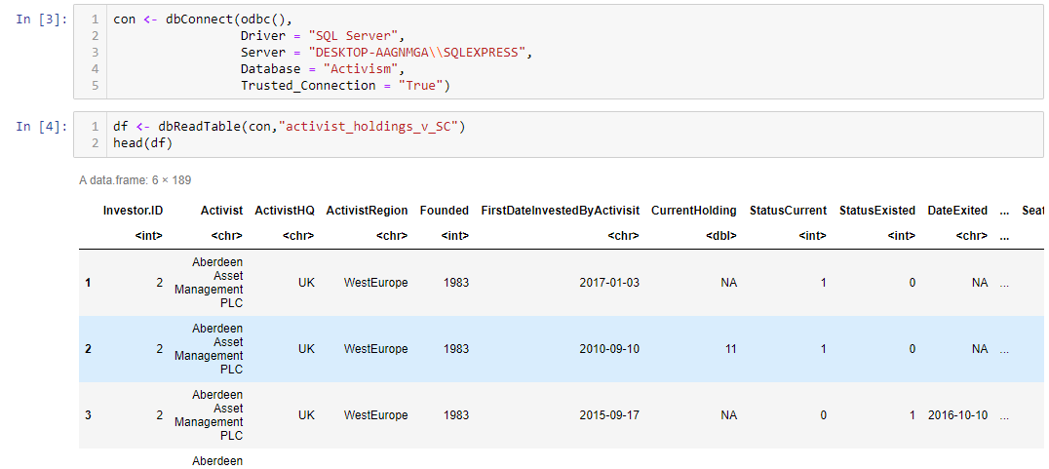
THE DATA
A Data.Frame: 9299x189 ; Target=Succession (Categorial 1/0)
Target: CASE WHEN (a.[Follower Return Annualised (%)]/ a.[S&P Change Annualised (%)]-1>0.5) THEN (1) ELSE (0) END AS Succession

Slide 7

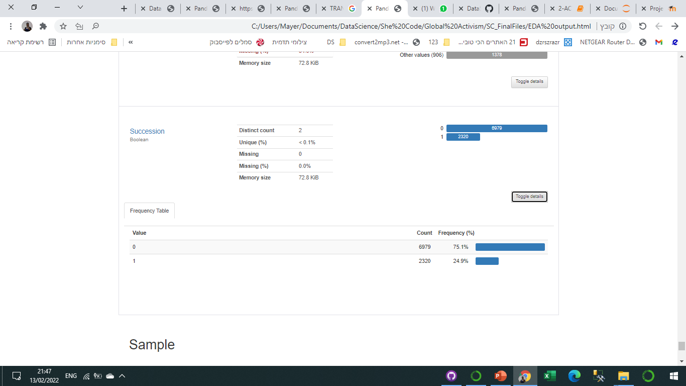
EDA – Data Visualization
Using Pandas-Profiling package for statistical and visualized insights. Full Report

Slide 8
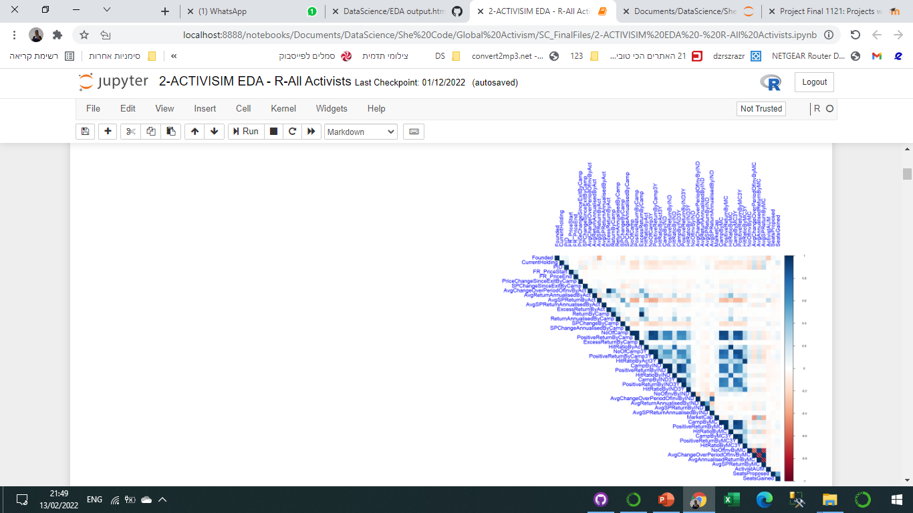
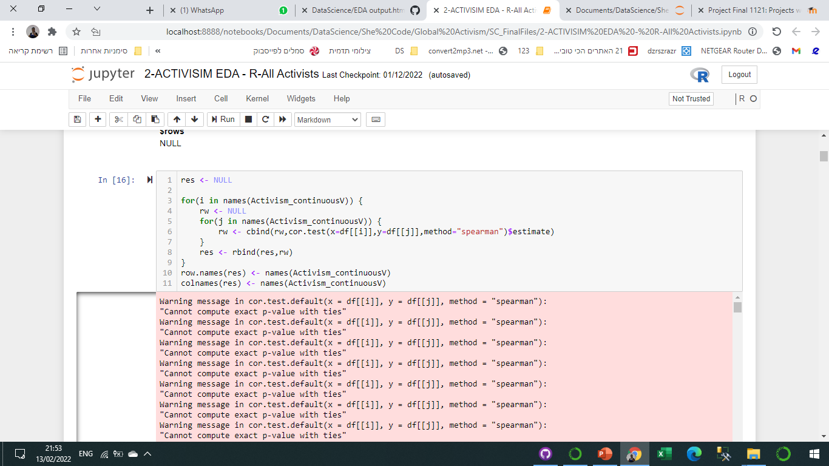
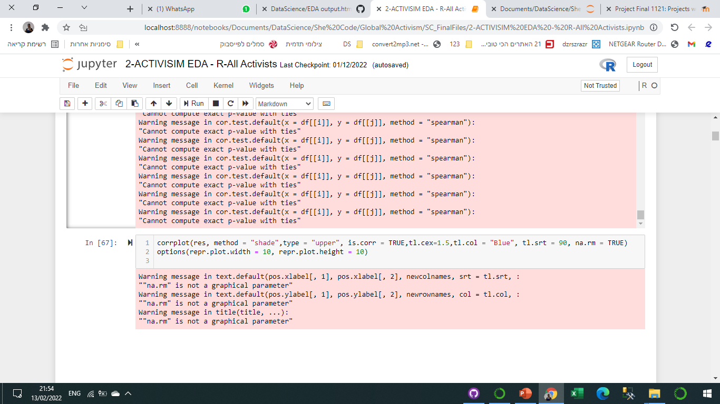
EDA - Correlation
Correlation matrix between continues variables

Slide 9
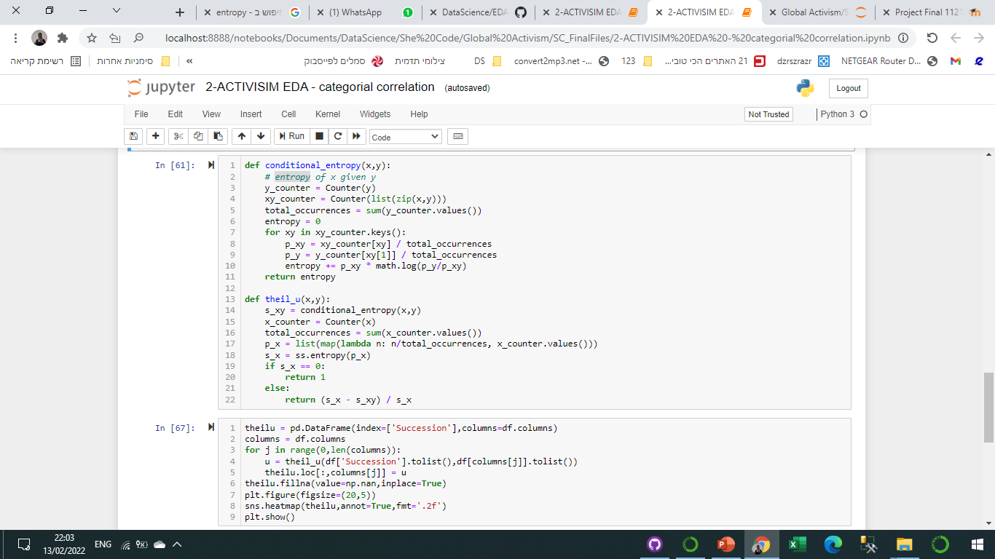
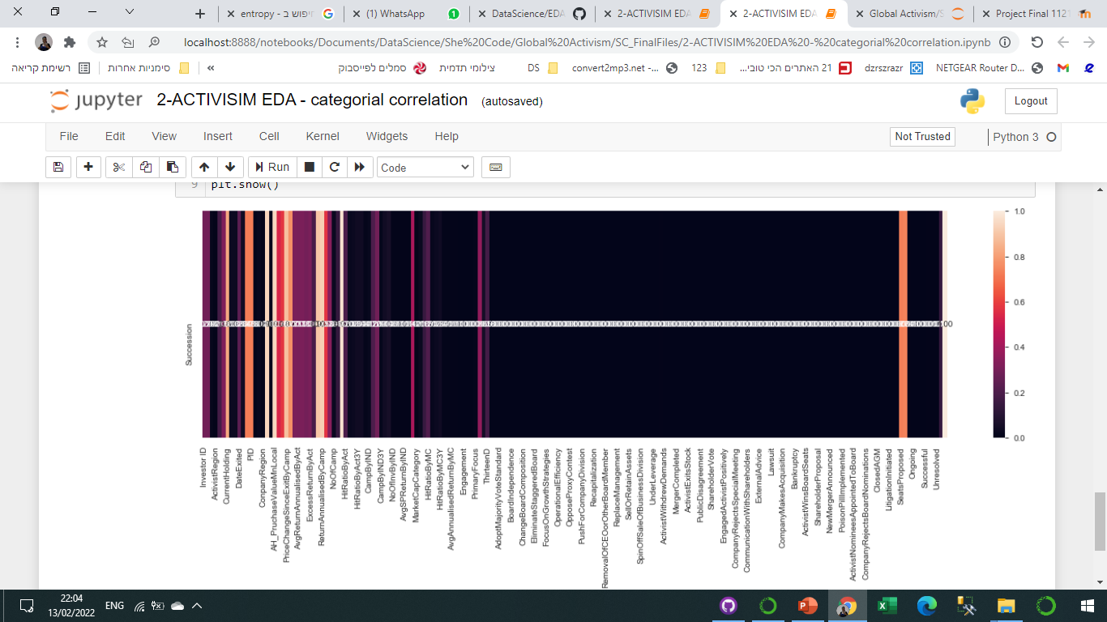
EDA - Correlation
Correlation between target ‘Succession’ to categorial variables

Slide 10
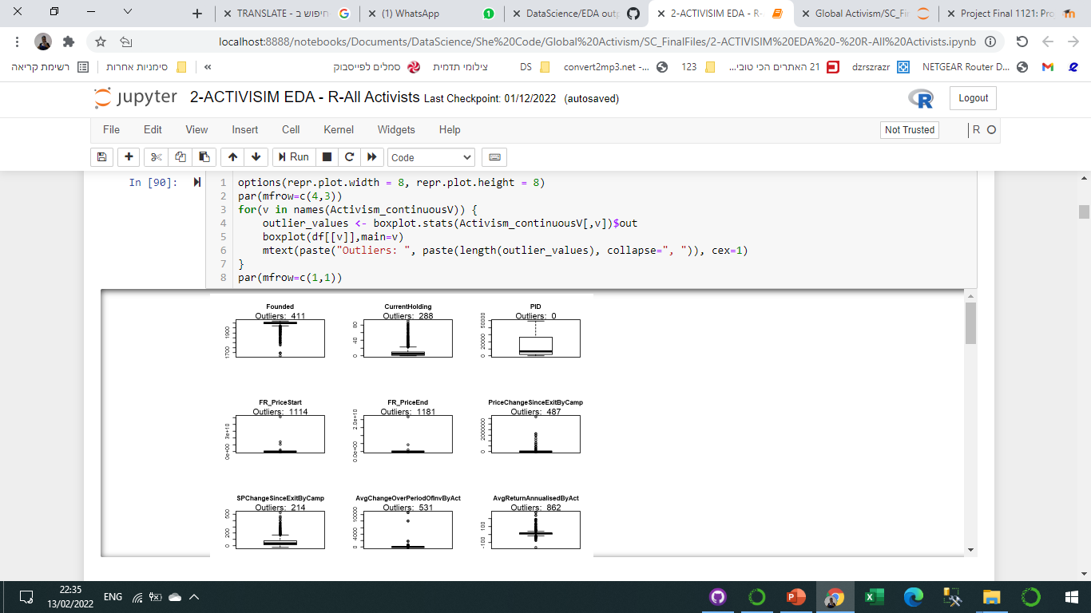
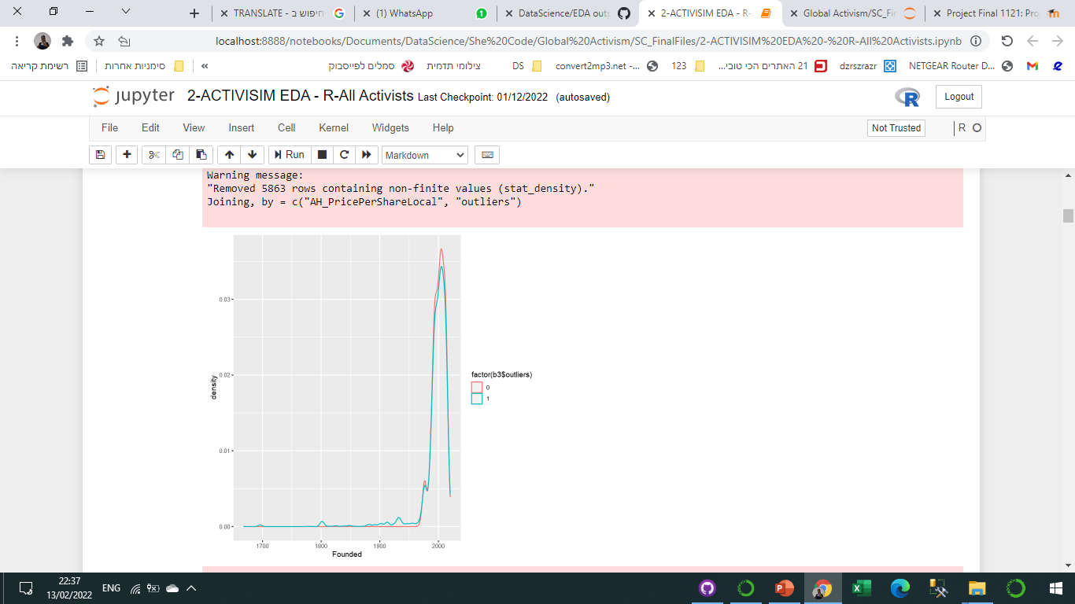
Detecting Outliers using outliers’ matrix
Checking the distribution with(blue) / without outliers(red)
Correlation matrix - Y + X(with outliers) & X(without outliers)
EDA – Data Cleaning - Outliers
Result DF

Slide 11
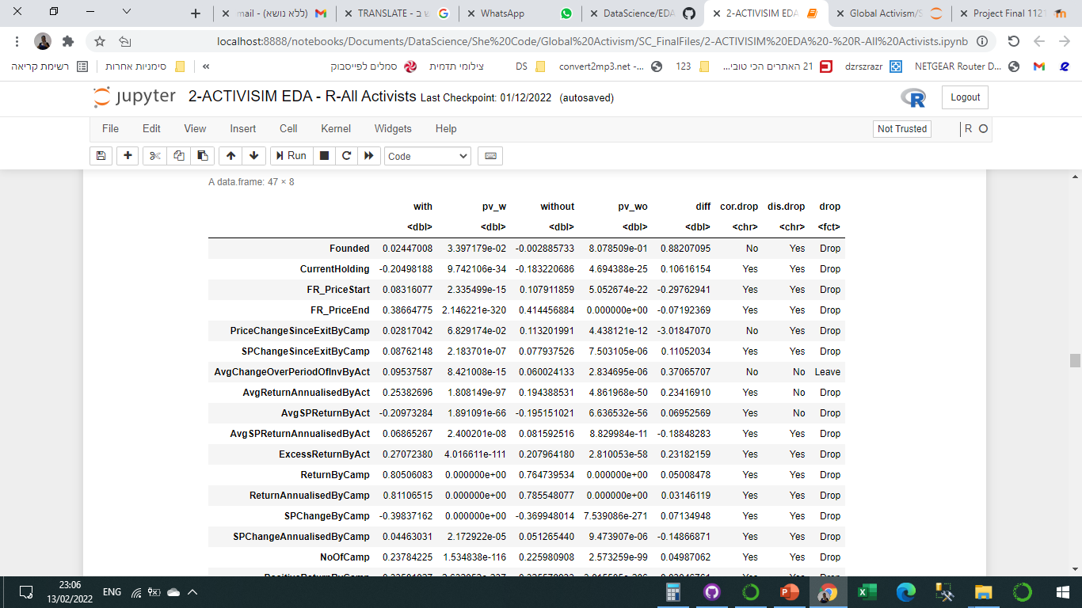
Detecting Outliers using outliers’ matrix
Checking the distribution with(blue) / without outliers(red)
Correlation matrix - Y + X(with outliers) & X(without outliers)
EDA – Data Cleaning - Outliers
Result DF

Slide 12
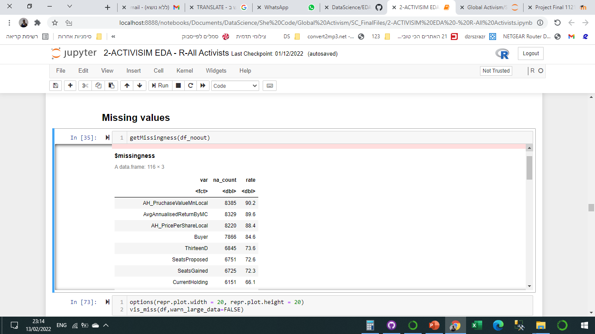
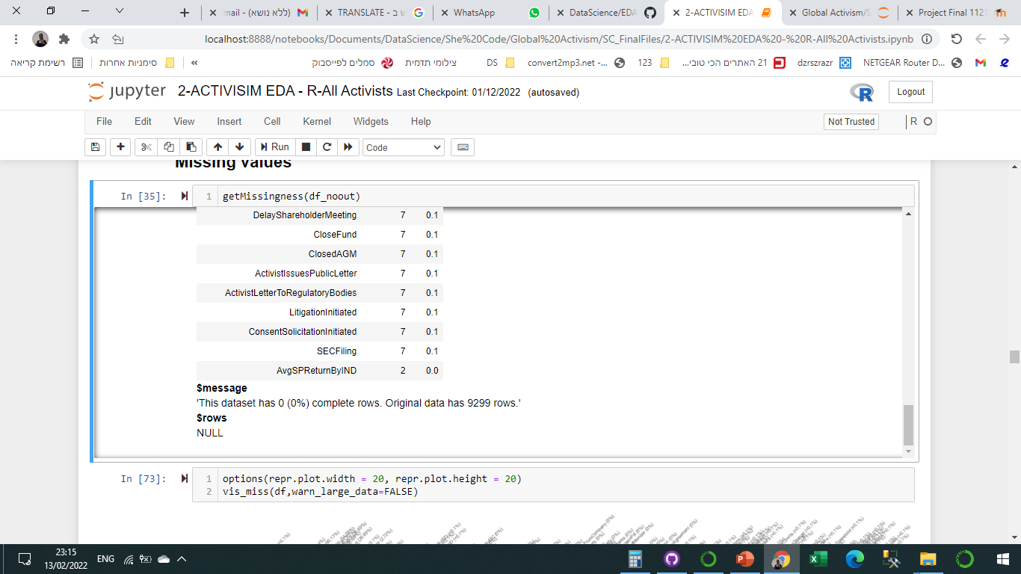
EDA – Data Cleaning – Missing Values
Summarizing missing values after outliers' treatment

Slide 13
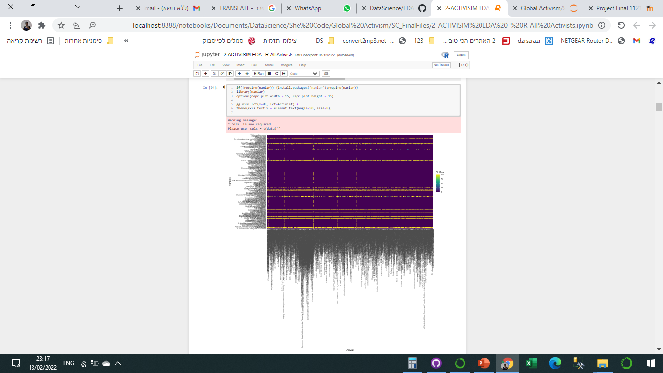
EDA – Data Cleaning – Missing Values
Heatmap for missing values

Slide 14
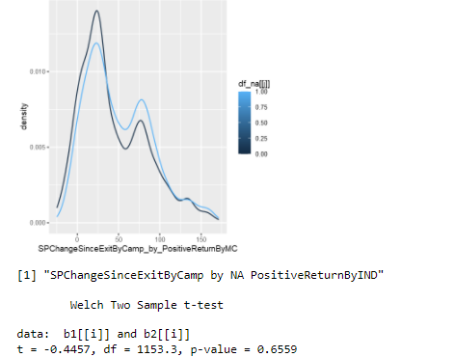
EDA – Data Cleaning – Missing Values
Determinate the Missingness Generation Mechanism
By the distribution and the t-test I assume that the missing mechanism is MNAR

Slide 15
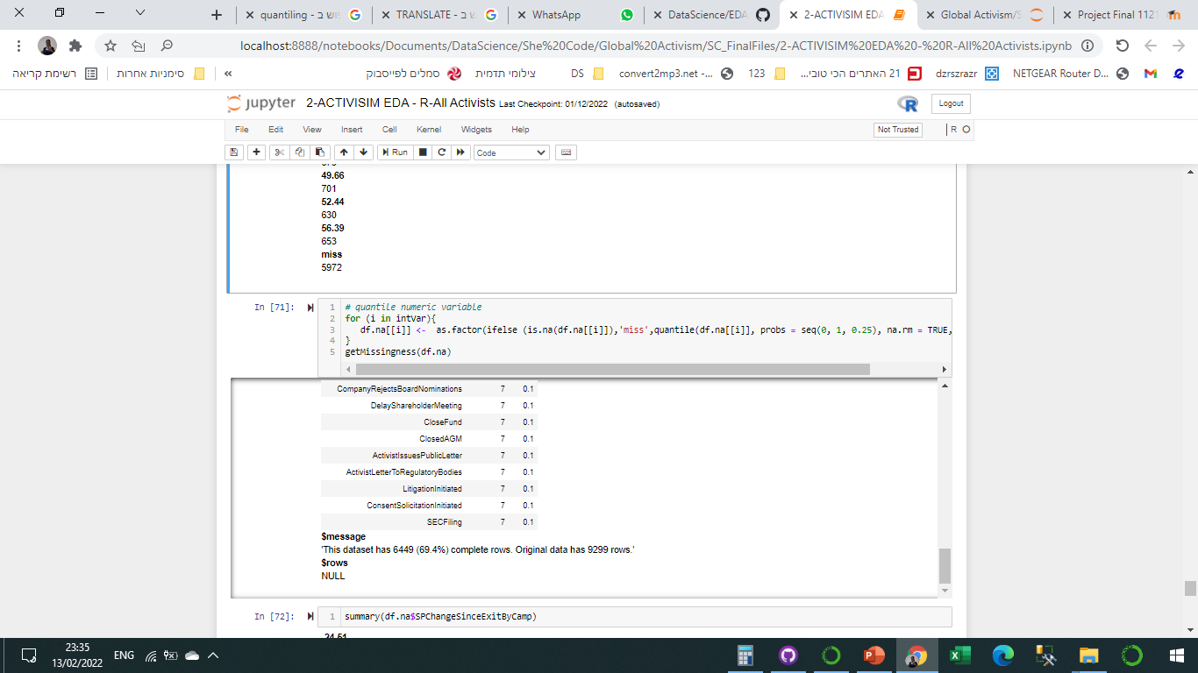
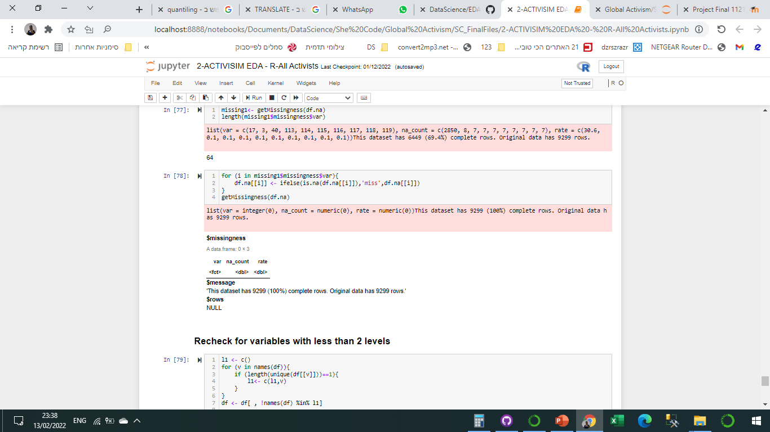
EDA – Data Cleaning – Missing Values
Treatment:
Quantile numeric variable and adding ‘miss’ category
For categorical vars with >10% missing – add ‘miss’
Re-Check for Outliers and missing values

Slide 16
EDA – Notes and challenges
A wrong ‘ifelse’ transcript converted big part of the data to NA.
Outliers’ treatment

Slide 17
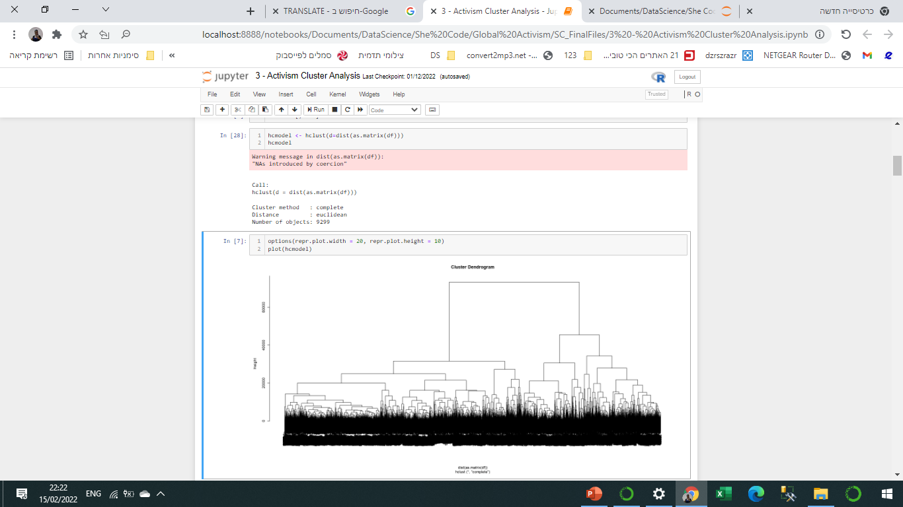
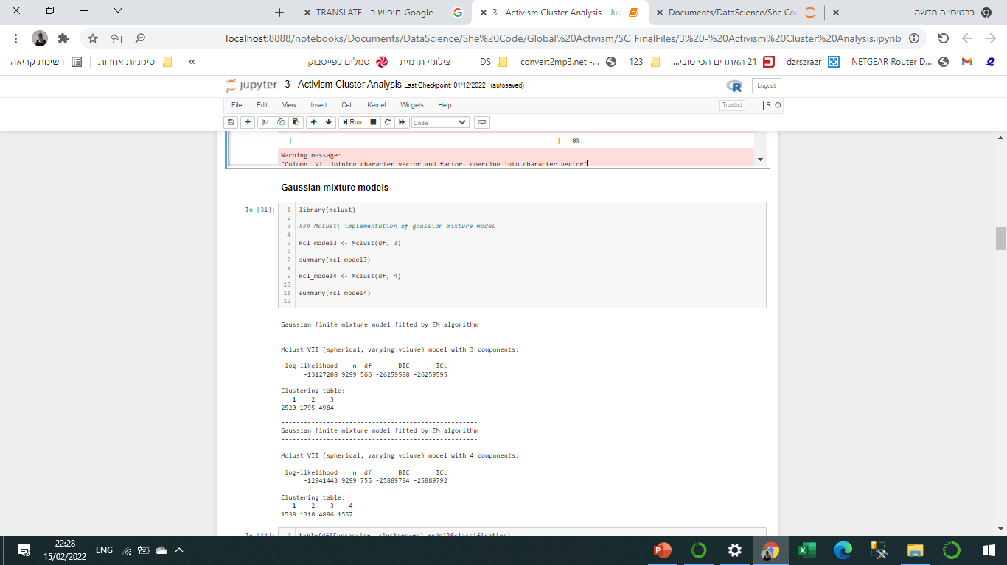
CLUSTER ANALYSIS
Adding 2 type of clusters to the data, Threshold 3 and 4 :
Hierarchical clustering – hclust.
Gaussian mixture models – mclust.

Slide 18

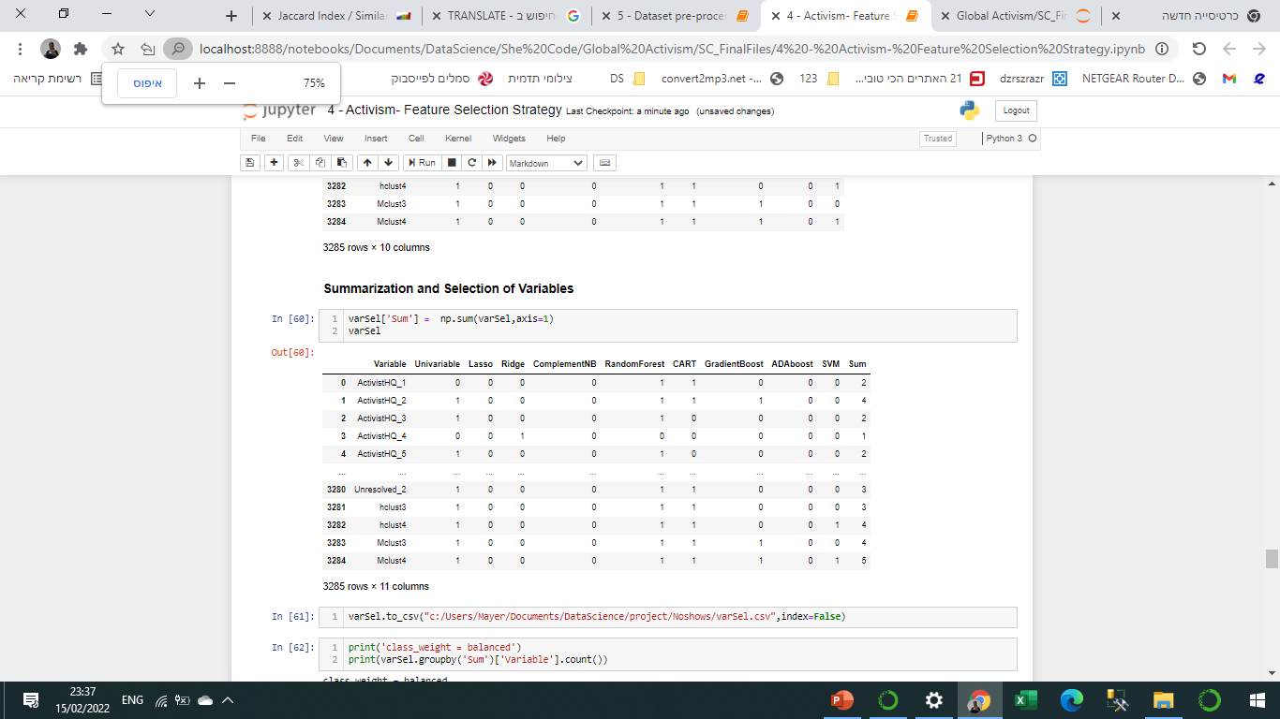
FEATURE SELECTION STRATEGY
2 methods for feature selection:
Univariable Analysis – Selecting features with p_value≤0.05
Multivariable Analysis – Using Lasso, Ridge, Naïve Bayse, Random forest, etc.
Summarization and Selection of Variables – Threshold=1

Slide 19
FEATURE SELECTION – Notes and challenges
Memory error due to high cardinality on ‘one hot encoding’.
Using data batches for the encoder gave me different features which I couldn’t join back to DF

Slide 20
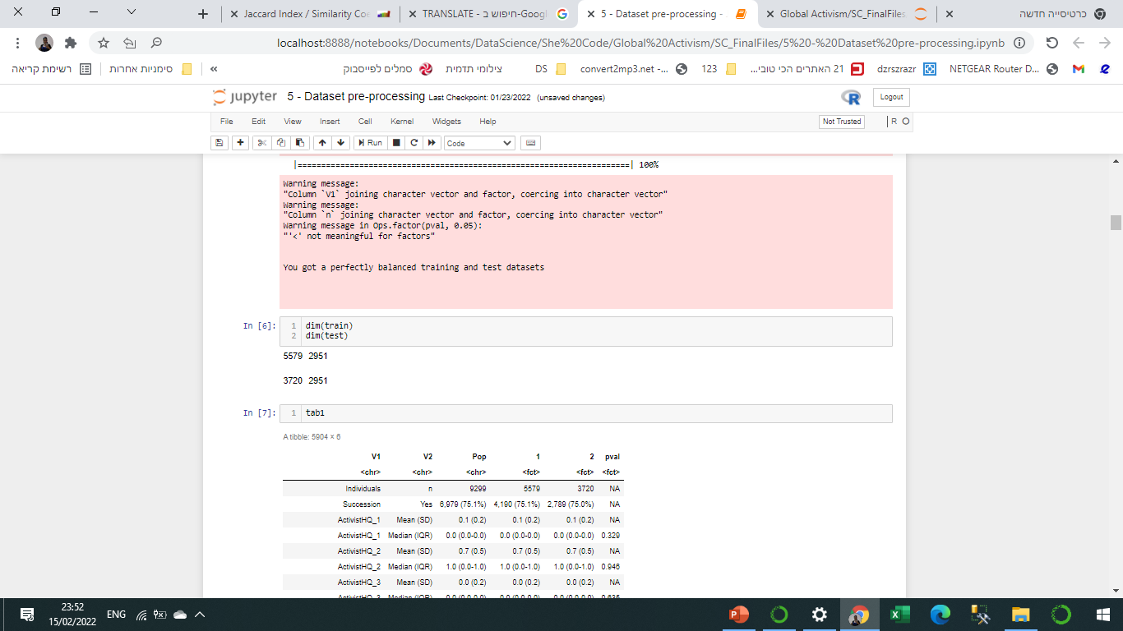
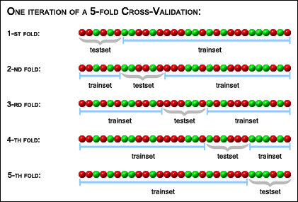
DATA PRE-PROCCING – Preparing the data
Splitting data to train-dev-test
Using cross validation for Train-Dev

Slide 21
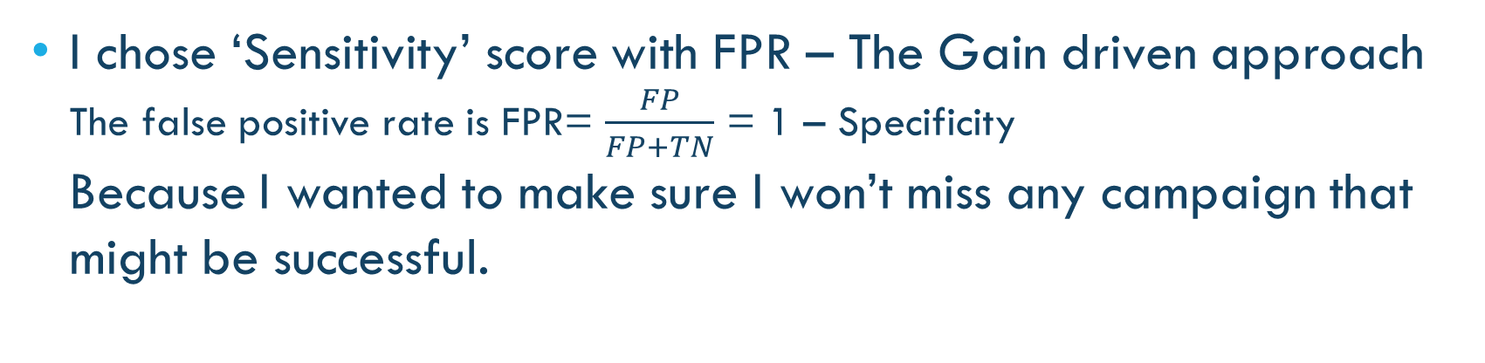
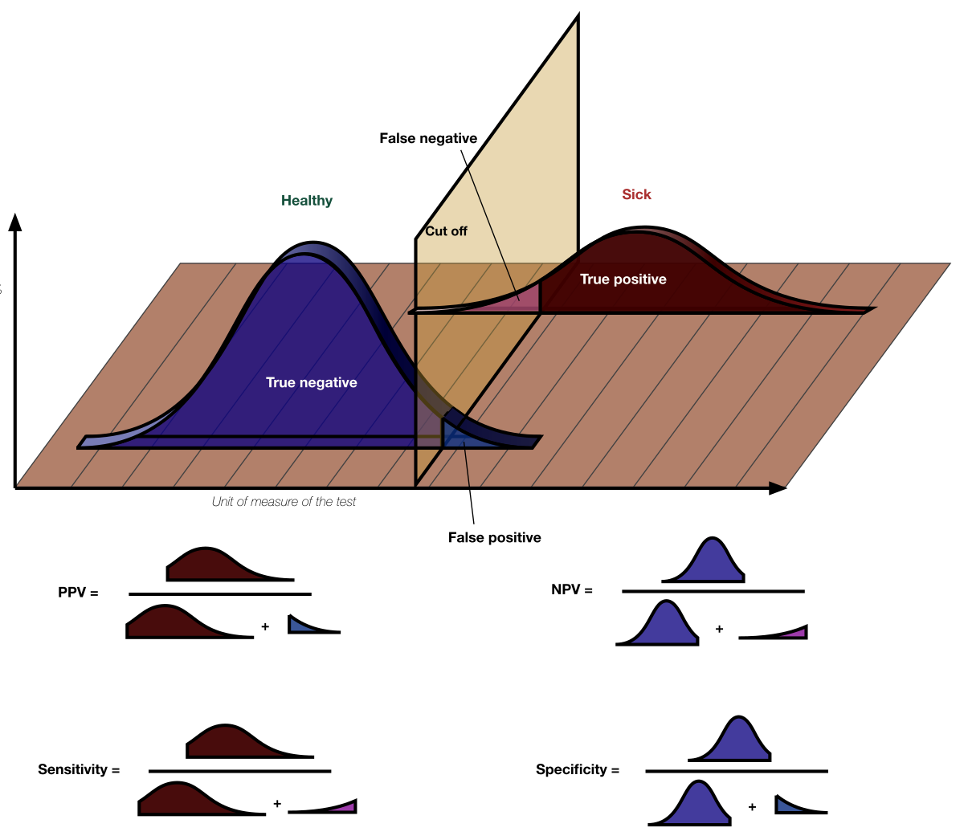
CLASSIFICATION MODELS – Metric Selection
I chose ‘Sensitivity’ score with FPR – The Gain driven approach
The false positive rate is FPR= $\frac{FP}{FP+TN}$ = 1 – Specificity
Because I wanted to make sure I won’t miss any campaign that might be successful.
Sensitivity vs. Specificity

Slide 22
CLASSIFICATION MODELS - CV strategy Selection
StratifiedKFold and StratifiedShuffleSplit for imbalance data
Category | #
0 | 6,979
1 | 2,320
Imbalance Ratio: 1/4

Slide 23
CLASSIFICATION MODELS - Results
Model with the highest sensitivity score and the lowest FPR
Results

Slide 24
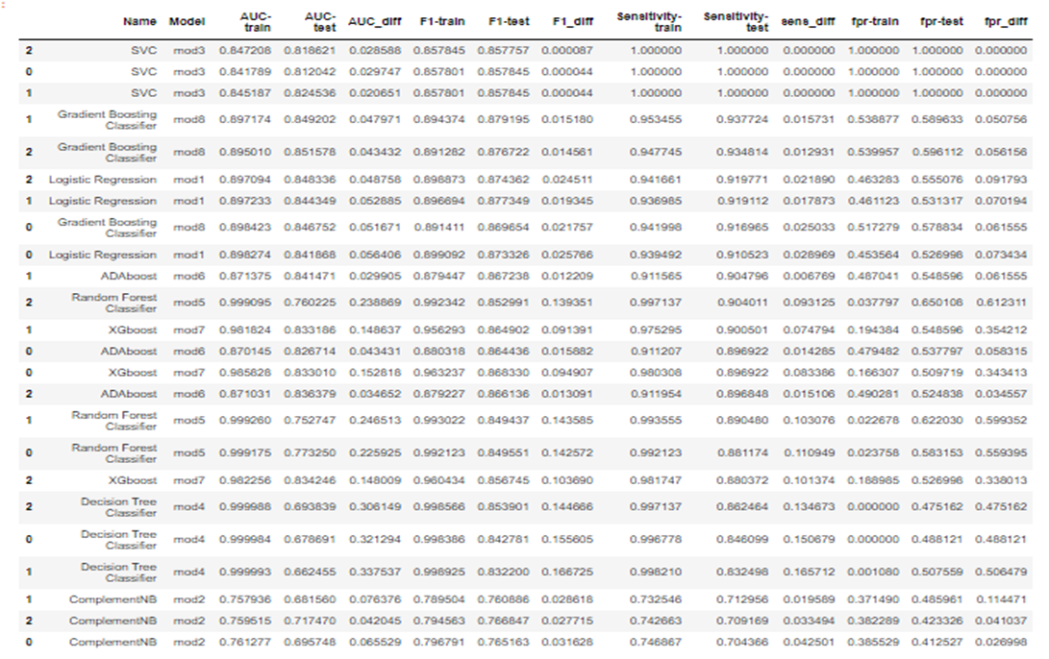
CLASSIFICATION MODELS

Slide 25
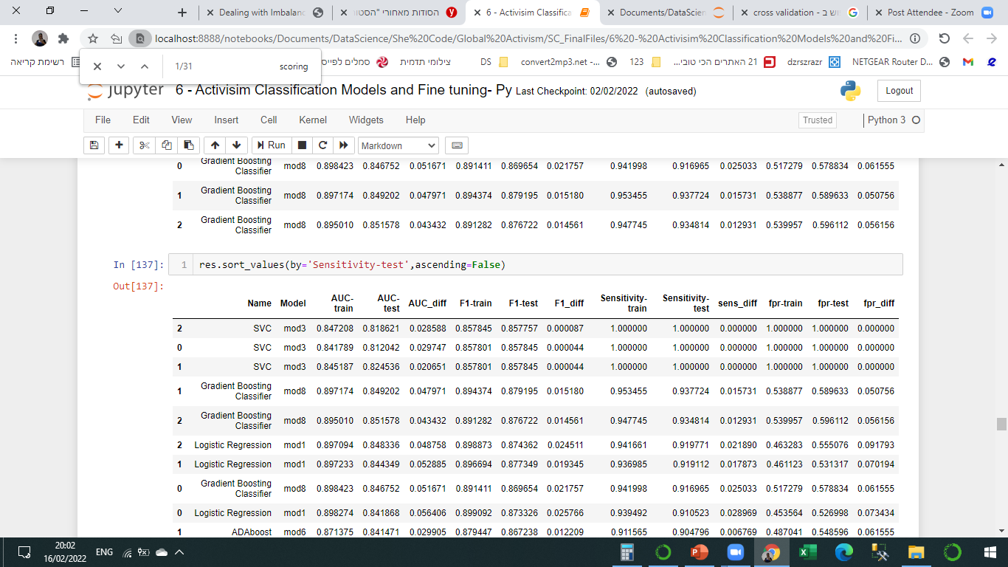
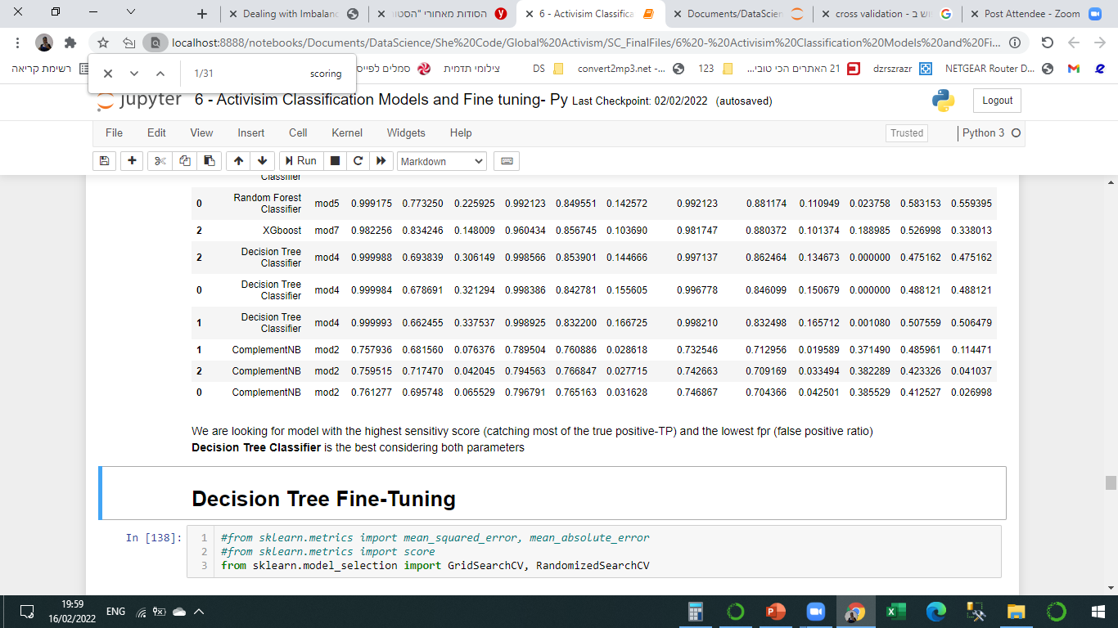
CLASSIFICATION MODELS – Model selected
Decision Tree Classifier is the best considering both parameters

Slide 26
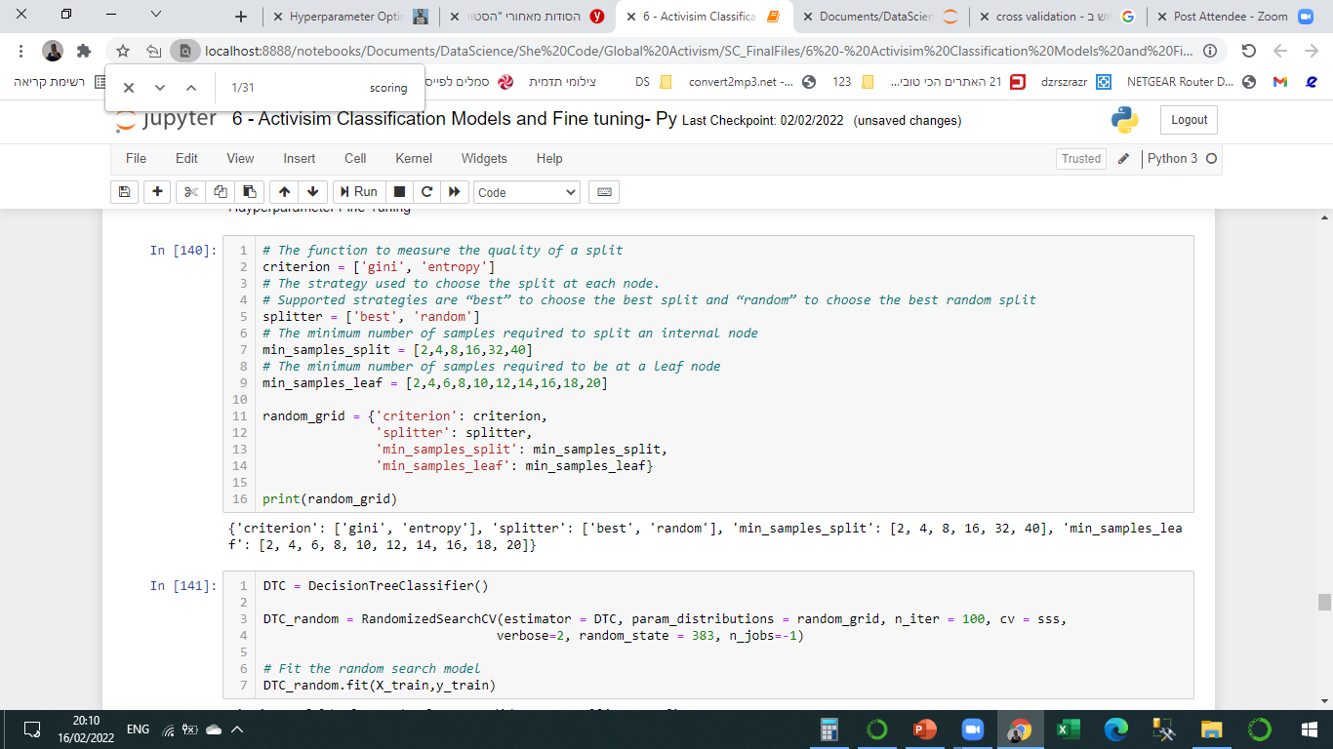
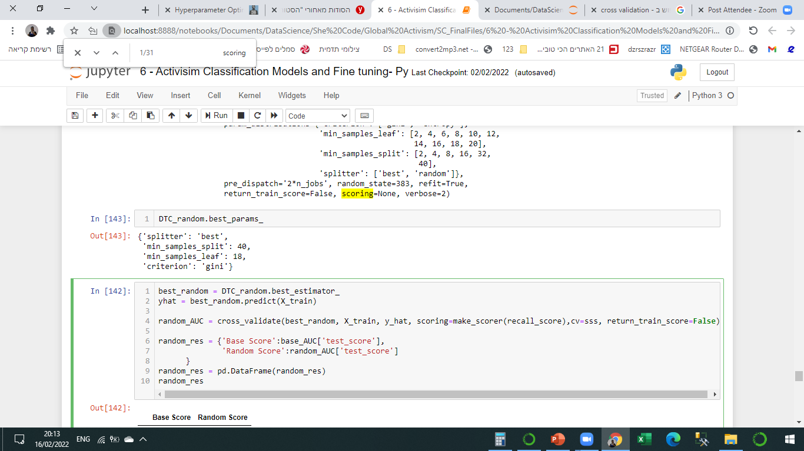
CLASSIFICATION MODELS – Fine Tuning
Random search and Grid Search for hyperparameter optimization
Random search

Slide 27
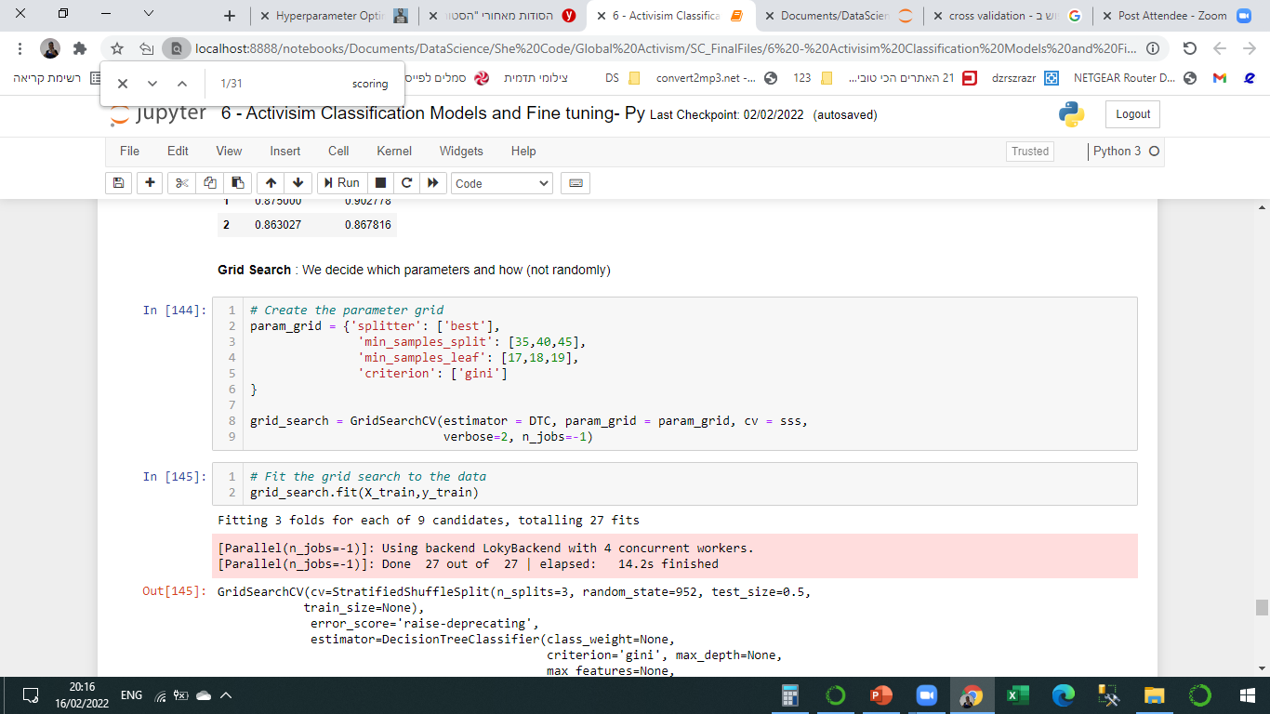
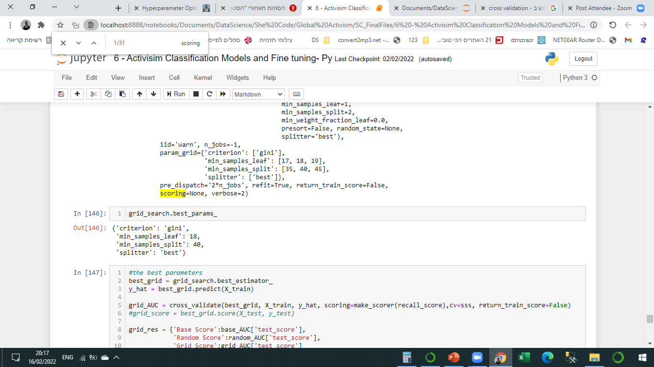
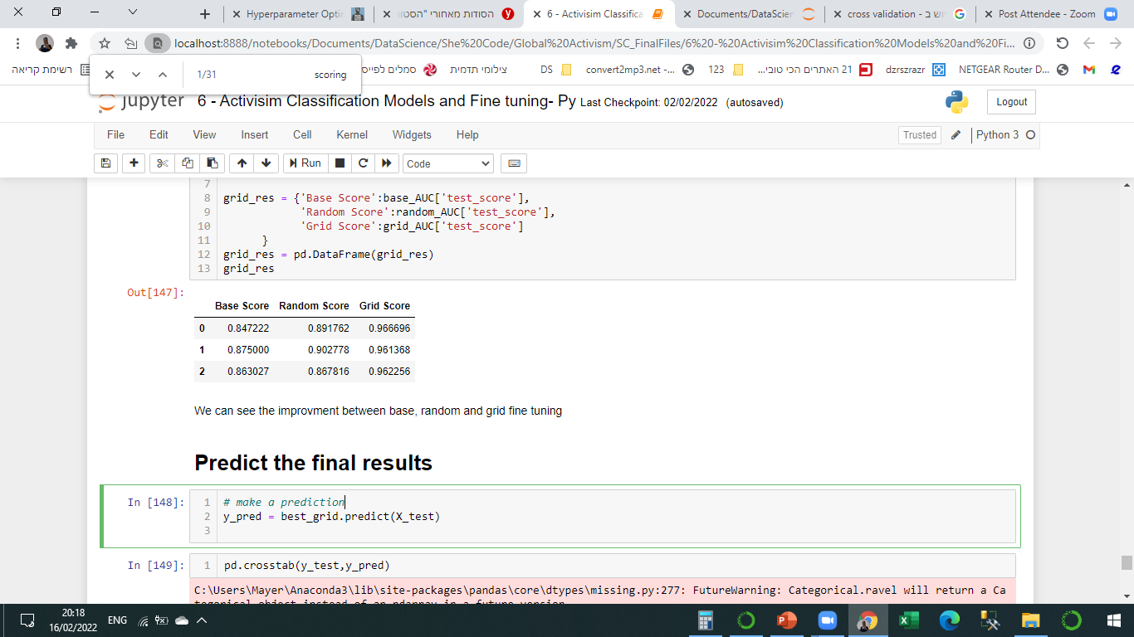
CLASSIFICATION MODELS – Fine Tuning
Grid search - We decide which parameters and how (not randomly)
We can see the improvement between base, random and grid fine tuning

Slide 28
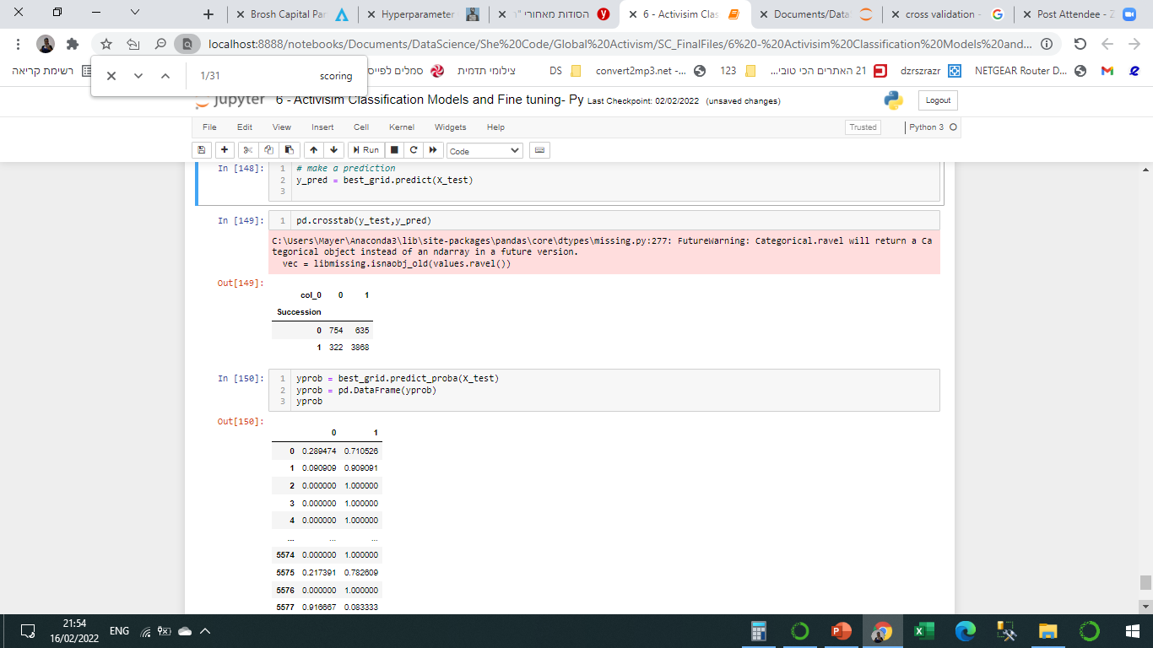
PREDICTIONS

Slide 29
FUTURE DEVELOPMENT
Training day0 set (features from 13D)
Selecting model by a conservative approach (Specificity)
Production

Slide 30
Thank you

